Slide 1
Colla-Config presentation
Presented by
Sabrine Edded

Slide 2
Agenda
Introduction
Software Product Lines
Variability documentation: Feature modelling
Configuration of Product Lines
Main concepts of Colla-Config
Colla-Config tool demo

Slide 3

Introduction
Telephony Industry
Need a way to produce a large variety of mobile phones within a short time period.
Answer: Create a standard family and modify this basis to meet customers needs.
Can we apply these techniques to Software Engineering ?

Slide 4
Software Product Lines
“Software product line engineering is a paradigm to develop software applications (software intensive systems and software products) using platforms and mass customization.”
Mass Customization – Large-scale production of goods tailored to individual customers’ needs
Platform – Any base of technologies on which other technologies or processes are built.

Slide 5
Software Product Lines
Two main parts of a software product line:
Domain Platform
“A software platform is a set of subsystems and interfaces that form a common structure from which a set of derivative products can be efficiently developed and produced”
Derivative Applications
Distinct products that were realized by using the platform.

Slide 6
Software Product Lines
Motivations to use software product lines:
Reduction of development costs
Enhanced quality
Platform heavily tested
A lot of reuse
Reduction of time to market

Slide 7
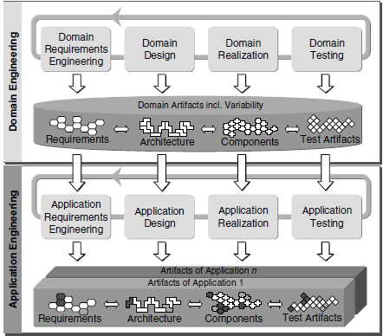
Engineering the Product Line
Broken into two distinct processes: domain engineering and application engineering
Domain engineering: The aim of the domain engineering process is to define and realise the commonality and the variability of the software product line.
Application engineering: The aim of the application engineering process is to derive specific applications by exploiting the variability of the software product line.

Slide 8

8
Variability in the Product Line
Variability is introduced during the product management sub-process when common and variable features of the software product line applications are identified.
During domain engineering, variability is introduced in all domain engineering artefacts (requirements, architecture, components, test cases, etc.).
It is exploited during application engineering to derive applications tailored to the specific needs of different customers.
8

Slide 9
9
Variability documentation: Feature modelling
It is necessary to document variability by:
Holding variation information directly in UML diagrams
Feature Diagrams
Orthogonal Variation Model (OVM)
9

Slide 10
10
Variability documentation: Feature modelling
Feature: a prominent or distinctive user-visible aspects, quality, or characteristics of a system.
Feature model: is a compact representation of all the products of a Software Product Line in terms of "features". Feature models are visually represented by means of feature diagrams.
Relationships between a parent feature and its child features (or sub features) are categorized as:
Mandatory – child feature is required.
Optional – child feature is optional.
Or – at least one of the sub-features must be selected.
Alternative (xor) – one of the sub-features must be selected
10

Slide 11
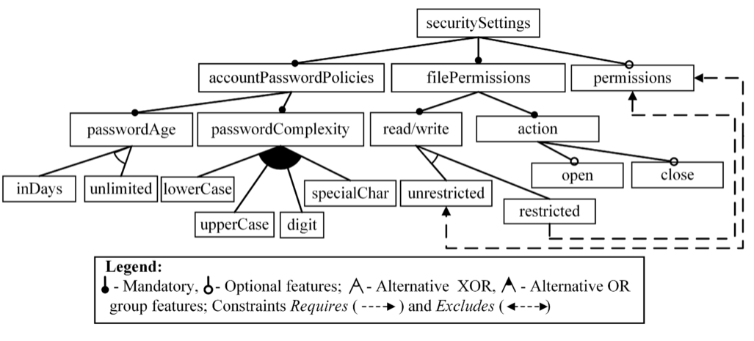
11
Variability documentation: Feature modelling
In addition to the parental relationships between features, cross-tree constraints are allowed. The most common are:
A requires B – The selection of A in a product implies the selection of B.
A excludes B – A and B cannot be part of the same product.
11

Slide 12
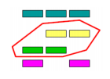
Configuration of Product Lines
Product Line Configuration
Represents the feature selection activities of a desired product in accordance with:
- User requirements.
- The product line specification constraints.

Slide 13


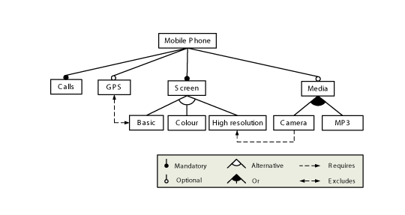
13
Configuration of Product Lines
Configuration process
Derived product
Features
Feature model

Slide 14
Collaborative configuration of Product Lines problem
14
In the context of software product line engineering, collaborative configuration is a decision-making process where multiple stakeholders contribute in building a single product specification.
Collaborative Configuration Process(CCP) (Mendonça et al., 2008)

Slide 15
Collaborative configuration of Product Lines
Functionalities
Etc.
Contradictory choices lead to conflicting situations!
Size
Price
Color

Slide 16
Main concepts of Colla-Config
Three main characteristics of the proposed approach:
Approach relying on Free Order Process.
Provides explicit information about conflict and its possible types.
Offers preference-based conflict resolution strategy

Slide 17
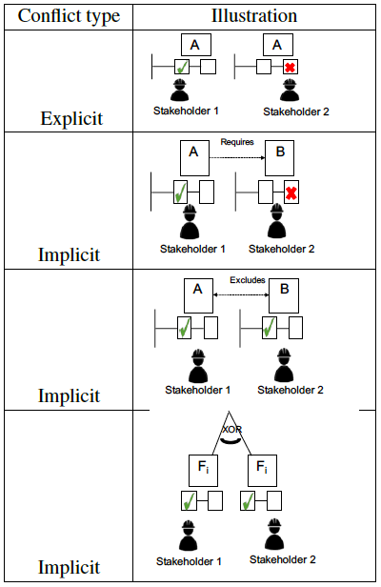
Main concepts of Colla-Config: Conflict types
Conflicts can be categorized into two different types:
Explicit Conflict: where the configuration decisions about the same feature made by two or more stakeholders are contradictory (feature selected by a stakeholder and undesired by another).
Implicit Conflict: where the configuration decisions of different stakeholders do not respect the constraints of the model / domain of the product line.

Slide 18
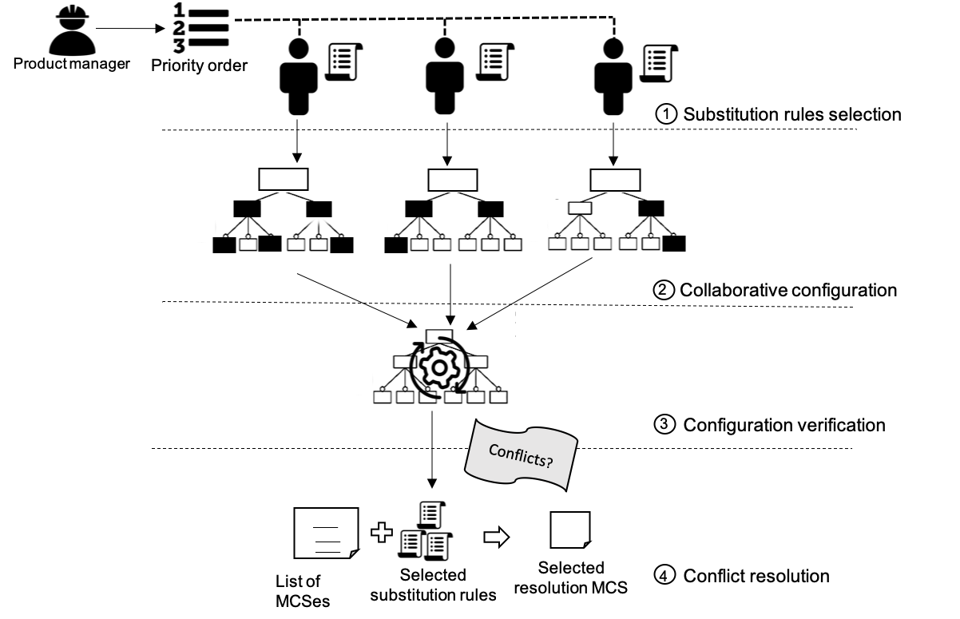
Main concepts of Colla-Config
Priority order is assigned to stakeholders
Substitution rules represent a recovery plan that permit
stakeholders to express their preferences if one or more of their configuration decisions could not be retained in case of conflict.
In case of conflict, MCSs are computed and the selected rules are applied on the list to identify the resolution MCS which is the one common among all these rules.
the different stakeholders freely express their configuration decisions towards the desired product without being constrained to the configuration decisions made by the other
stakeholders.

Slide 19
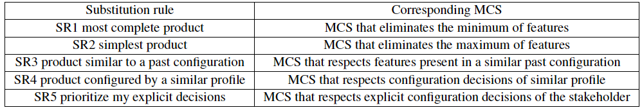
Main concepts of Colla-Config : Conflict resolution
List of rules selected by stakeholders
SR1. Most complete Product : includes the maximum as possible of features selected by the different stakeholders.
SR2. Simplest Product : includes the minimum as possible of features selected by the different stakeholders.
SR3. Product Similar to a Past Configuration : previous configuration that contains the same features selected by the current stakeholder.
SR4. Product Configured by a Similar Profile : the configuration decisions made by the current stakeholder will be aligned with those made by the stakeholder with the same profile.
SR5. Prioritize my Explicit Decisions : considering configuration decisions explicitly expressed through feature selection.
Applied on
List of computed MCSs
MCS (Minimal Correction Subsets) is an irreducible subset of constraints whose removal makes satisfiable a constraint program.( (Liffiton and Sakallah, 2008).
In the proposed approach MCSs are computed to identify the minimal set of conflicting configuration decisions to be deleted.
.
Resolution MCS
The result of rules application on the list of computed MCSs

Slide 20
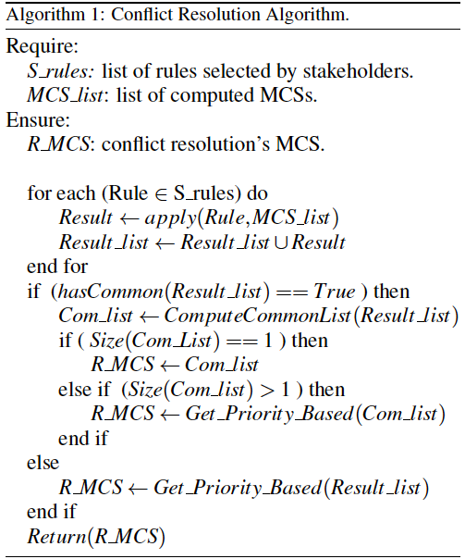
Application of selected rules on the list of computed MCSs
Checking if there is a common MCS between rules
which is returned as resolution MCS
If there is no common MCS, the resolution MCS will be selected according to the priority order

Slide 21

Collaborative configuration of Product Lines: collaboration forms
21
During the experiment part 2 configuration
activities will be coordinated according to a workflow-based plan where a specific module of the feature model will be assigned for each participant by the Product manager.
In case of conflict, the resolution relies on a systematic process by prioritizing configuration decisions made at earlier stage
During the experiment part 1 you will configure a product by freely expressing your configuration decisions without imposing a selection order on you.
The feature model will be totally shared between all the participants.
In case of conflict, the resolution will be based on the substitution rules you will select.
1. Sharing of all configuration decisions
2. Assignment of configuration decisions

Slide 22
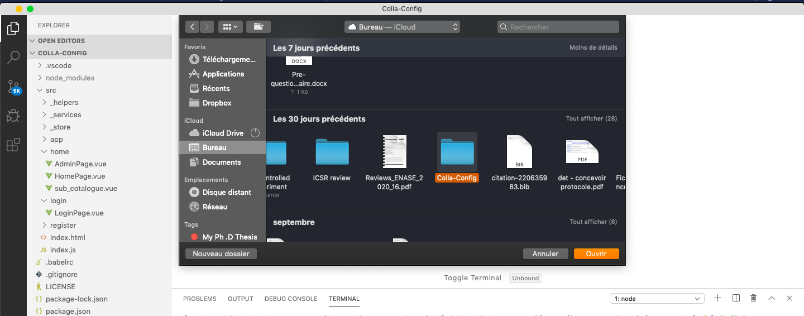
Colla-Config tool demo
Unzip and import the zip file of the tool on visual studio via the following link :
https://github.com/sabrinacri/Colla-Config-tool

Slide 23
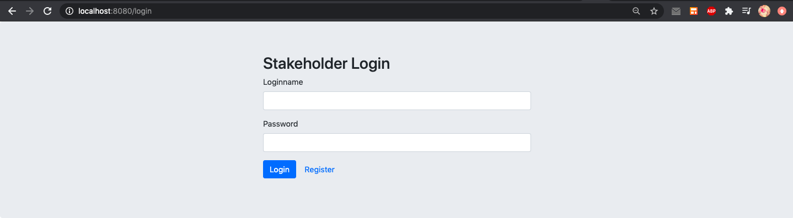
Colla-Config tool demo
2.In the visual studio terminal type Npm install then Npm start
3. In the launched web page click on “ Register ”

Slide 24
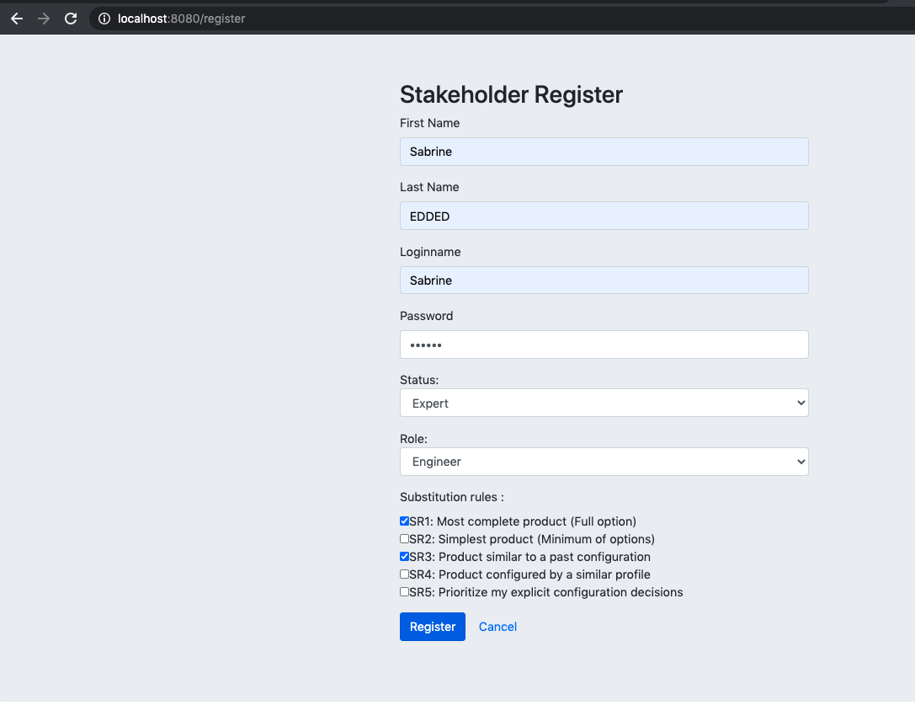
Colla-Config tool demo
4. Fill the form and click on “ Register ”

Slide 25
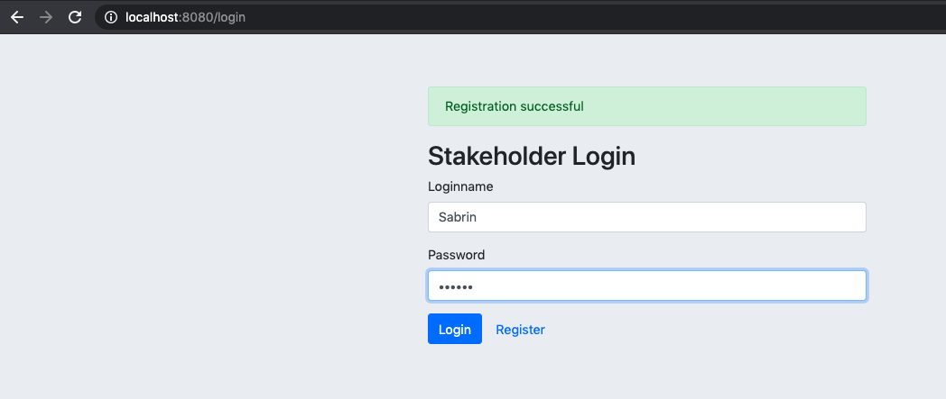
Colla-Config tool demo
5. Login with your Login name and pwd

Slide 26
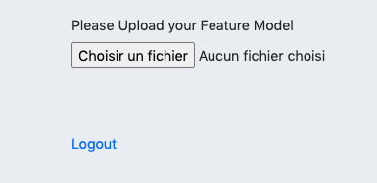
Colla-Config tool demo
5. Download in import the feature model file via this link: github.com/sabrinacri/Colla-Config-tool/Web_portal_model.xml

Slide 27
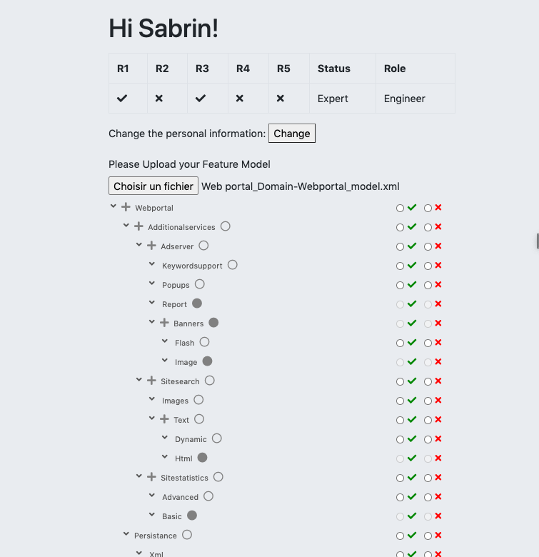
Colla-Config tool demo
6. Express your configuration choices by selecting the desired and undesired characteristics

Slide 28

Colla-Config tool demo
7. Save your choices and log out

Slide 29
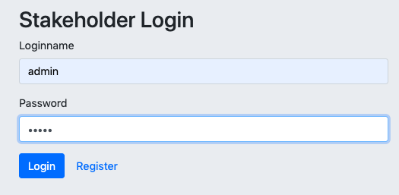
Colla-Config tool demo : Product manager interface
1. To check the configuration, the Product manager connects with login “admin” and password “admin”

Slide 30
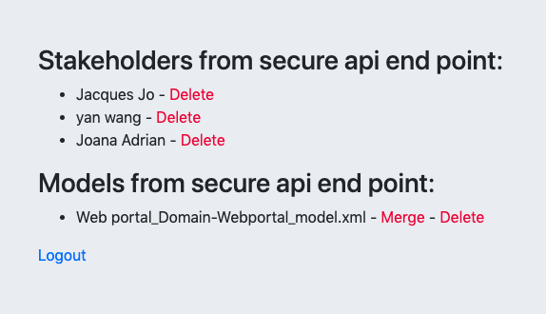
Colla-Config tool demo : Product manager interface
2. Click on “Merge” to merge participants choices

Slide 31
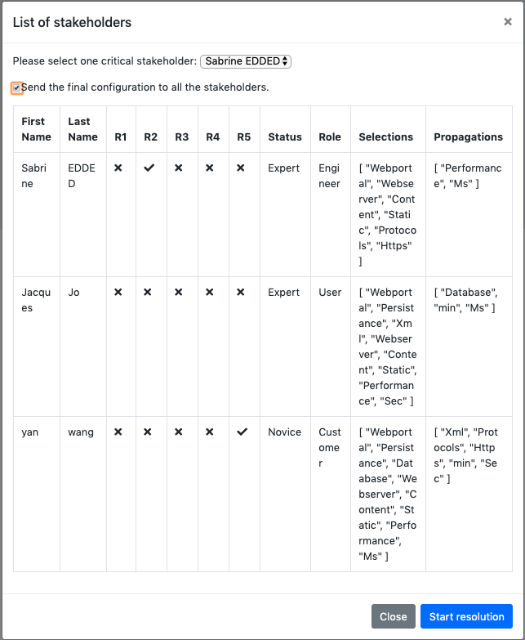
Colla-Config tool demo: Product manager interface
(3)
3. Select a critical stakeholder, this one his choices are going to be respected if there is no common MCS (choices to be deleted) between all participants
The following interface represents a synthesis of the different participants’ choices and rules
4. Click on “start resolution” to start conflict detection and resolution process
(4)

Slide 32
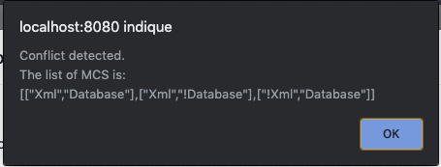
Colla-Config tool demo : Product manager interface
A window showing the detection result is displayed with the list of alternative combination of choices that should be deleted to resolve detected conflicts.
5. Click on “OK”

Slide 33
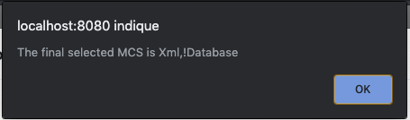
Colla-Config tool demo : Product manager interface
The combination of choices (MCS) according to the rules selected by participants is selected
6. Click on “OK”

Slide 34
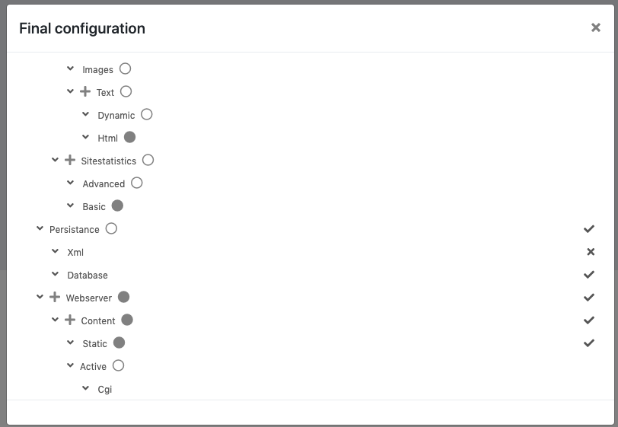
Colla-Config tool demo : Product manager interface
The Final configuration corrected according to the deleted conflicting choices and sent to all stakeholders

Slide 35
Thank you for your attention

